Slide 1
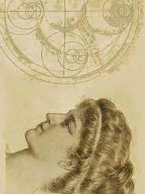
Our Unknown HERoine: Hypatia
Place of birth: Alexandria (370 A.D.)
Occupation: Neoplatonic philosopher, astronomer, mathematician, director of the Alexandria Neoplatonic School
«Unknown HERoines»

Slide 2
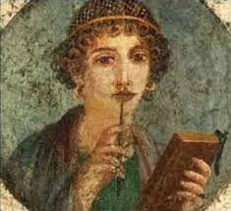
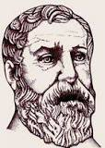
BIOGRAPHY
She was the daughter of Theonas Alexandreos, mathematician and astronomer
(335-405 A.D.)
She received her education in Athens, at the Neoplatonic School of Plutarch the Younger, and also in Italy
«Unknown HERoines»

Slide 3
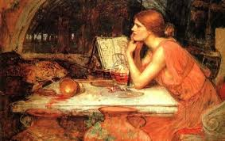
BIOGRAPHY
After returning to Alexandria, she took over the Platonic School
Her eloquence, her modesty and her beauty, combined with her mental talents, attracted a large number of students
She was a symbol of science, which was equal to paganism according to Christians at that time. So, she was the centre of tension among Christians and non-Christians
«Unknown HERoines»

Slide 4
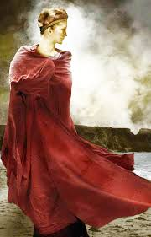
BIOGRAPHY
In 412 Kyrillos became Patriarch of Alexandria, and Hypatia was ‘targeted’ due to her relation with Orestis, the city’s prefect, who was a pagan
On March 8th 415 she was brutally murdered by a group of fanatic Christians
Her death marked the beginning of the end for Alexandria as an intellectual centre
«Unknown HERoines»

Slide 5
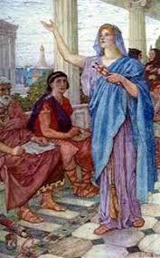
Hypatia as a teacher
She was very influential to important local rulers of the Mediterranean, Constantinople, Syria and Alexandria. She often discussed political matters with the Roman prefect Orestis
She taught two kinds of lessons: a private one (for the elite of her students) and also public speeches, thus proving her education in philosophy, mechanics and rhetoric
She was a respected, charismatic and loved teacher by her students
Her philosophy is known as Neoplatonic
«Unknown HERoines»

Slide 6
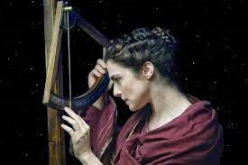
Hypatia as mathematician
Her mathematic work is only a small part of her total work
She did work in geometry, algebra and astronomy. She knew how to make astrolabes (a historical astronomic instrument that sailors used to navigate and observe the sun and stars
«Unknown HERoines»

Slide 7
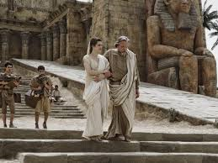
Her works
Some analysts believe that her works were written in Arabic, while others claim that her work was only about mathematical relations that she had created
She was very productive in terms of mathematics, recording comments about ‘Conic Sections’ by Apollonius, ‘Arithmetic’ by Diophantos and ‘Astronomic Rule’ by Ptolemy
Her most important work was in Algebra. She wrote 13 books of comments on Diofantos’ “Arithmetic”
«Unknown HERoines»

Slide 8
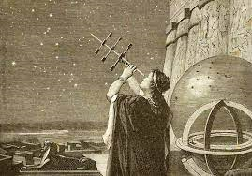
Her works
Unfortunately, only titles from her works are saved. This is because Serapeion and the Alexandria library, where her work was saved, were destroyed
From her correspondence with her students, we have obtained useful information about her deep knowledge of Philosophy and Mathematics
«Unknown HERoines»

Slide 9
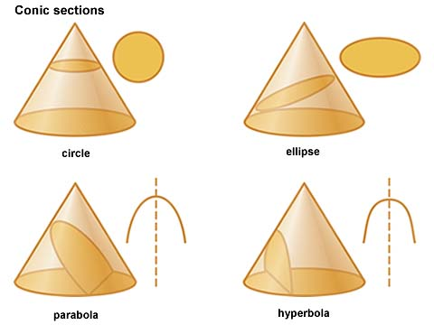
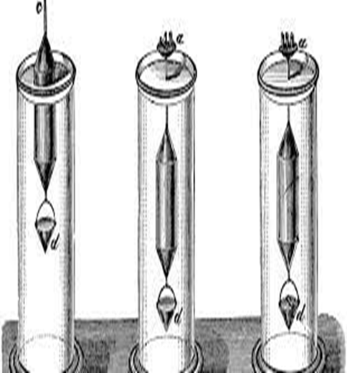
Her works
Influenced by Aristarchos’ theory of the heliocentric system, she did the mapping of celestial bodies
She studied Ptolemy’s ‘Astronomic Rule’
She perfected the ‘Apollonian Circles’ the cornerstone of projective geometry
She also invented the ‘pycnometer’, a scientific organ that measures the density of liquids
She also helped one of her students to make an astrolabe and a hydrometer
«Unknown HERoines»

Slide 10
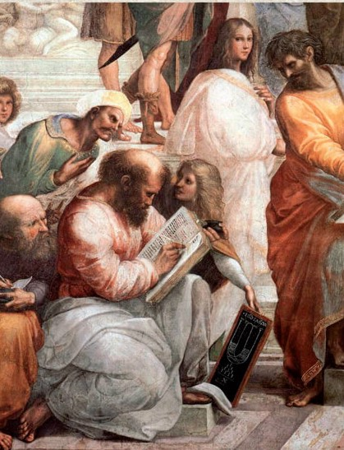
Her famous students
The students who followed her teachings came from the richest families of Alexandria. They were young men who wanted to receive higher education, so as to later claim high-ranking positions. Among the were: Orestis (who later became Prefect of Alexandria) and Synesios (later Bishop of Kyrini)
«Unknown HERoines»

Slide 11
The tragic end
While the Empire was being Christianised, religious fanaticism spread more and more
This fanaticism was instigated by Kyrillos, who wanted to abolish all the other religions and claim political influence
Hypatia found herself in a difficult place, in a city which was becoming more and more Christian
Kyrillos and Orestis became great enemies. After taking power, Kyrillos started persecuting the Jewish, sending them away from the city. Despite Orestis’ opposition, Kyrillos wanted to clear the city from the Neo-Platonists. Hypatia refused to give up her ideas and become a Christian
«Unknown HERoines»

Slide 12
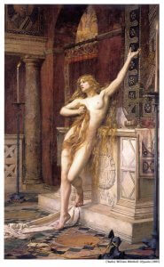
The tragic end
Kyrillos saw Hypatia as a constant threat to the Christian faith and a figure of evil. Hypatia, on the other hand, attacked Kyrillos for his thirst for power. This eventually turned the crowd against her
Socrates Scholastikos describes her brutal murder: «She was taken off her carriage by force and dragged to the Church. They ripped her clothes, tore and burnt her skin until she as dead; then they dismembered her and burnt her body parts»
«Unknown HERoines»

Slide 13
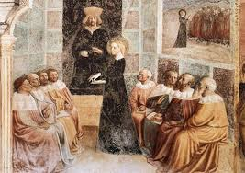
Some final words
She was the last mystic of ancient Greek philosophy. She was also the first woman who excelled at mathematics
She inspired her students with her restless spirit Her adamant character and her ascetic life made her look like a Christian archetype
Although she was a pagan, she lived and died like a Christian. Some people confuse her with Saint Catherine, since they were both murdered in Alexandria at about the same time
«Unknown HERoines»

Slide 14
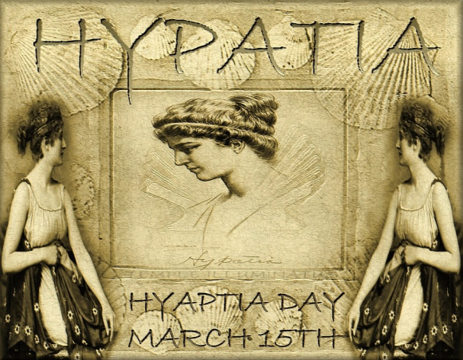
Some of Hypatia’s words of wisdom
“To believe in a religious doctrine requires nothing; to be free from it requires a lot of research, logic and judgement”
“The luckiest man is not the one who has money; he is the one who has someone to go through the worst storms of life together”
“If you manage to fool someone, it does not mean he is stupid; it means he trusts you more than you deserve”
“Without imperfection, neither you nor I would exist”
«Unknown HERoines»

Slide 15
Sources
https://filologika.gr/ypatia-gynaika-symvolo-tis-epistimis/
https://www.mixanitouxronou.gr/ipatia-i-alexandrini-filosofos-pou-vasanistike-ke-dolofonithike-apo-fanatikous-christianous-pou-tin-egdaran-ke-ti-diamelisan/
https://el.wikipedia.org/wiki/%CE%A5%CF%80%CE%B1%CF%84%CE%AF%CE%B1
https://tvxs.gr/news/san-simera/ypatia-i-gynaika-poy-dolofonithike-giati-itan-epistimonas
https://www.sansimera.gr/biographies/668

